Slide 1
Member institutions accessing electronic resource data from the network zone institution
Yoel Kortick – Senior Librarian

Slide 2
  Introduction
  Configuration in the network zone
  Configuration in the member institution
  Creating reports in member institution with network zone data

Slide 3


Introduction

Slide 4
Introduction
See also Configuring Analytics to Display Network Zone Information
It is possible to create reports in Alma analytics containing information from the Network Zone.
This means that from within a member institution information from the network zone will be available.
In order for this feature to be enabled a parameter in both the member institution and in the network zone should be configured.

Slide 5
Introduction
When creating reports in a member institution and including information from the network zone a special folder called “Portfolios details for consortia” is used.
When using this folder the advantages are:
  The institution can see all portfolios in the network zone even though the report is being made in the member institution.
  There is an indication for each of the portfolios as to whether or not it is “available for my institution”.
In this way the member institution can get an inclusive picture of what is in the network zone even though the report is being made from the member institution.

Slide 6
Introduction
As far as configuration is concerned:
  The network zone defines that they agree that members will be available to access data from the network zone.
  The member institutions define that they want to have the ability to access data from the network zone in their member institution reports.
It is a reciprocal agreement.

Slide 7

Configuration in the network zone

Slide 8
Configuration in the network zone
Step One
In the network zone navigate to “Configuration > Analytics > Analytics Networks Settings” and set the parameter “analytics_network_inventory_available_for_members” to true.
Step Two
In the network zone after setting “analytics_network_inventory_available_for_members” to true select “Manage in Network” from the row actions and then click “Save and Distribute”.

Slide 9
Configuration in the network zone
Step Three
After clicking “Save and Distribute” choose “Override member institution customization”.
The only value that this changes in the member institutions is that it allows the members to be able to define that they will be able to see data from the network zone in E-Inventory Alma Analytics reports.
It does not change anything else.

Slide 10
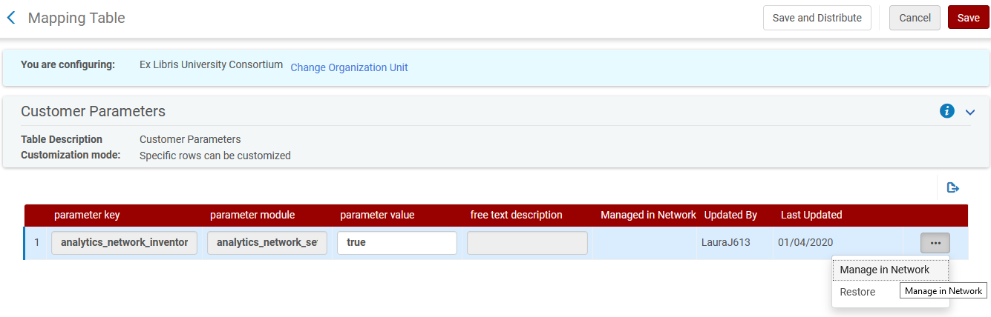
Configuration in the network zone

Slide 11
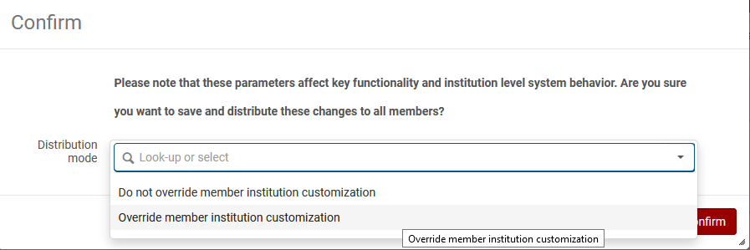
Configuration in the network zone

Slide 12

Configuration in the member institution

Slide 13
Configuration in the member institution
In the member institution navigate to “Configuration > Analytics > Analytics Member Settings” and set the parameter “analytics_network_inventory_available_for_my_institution” to true.

Slide 14
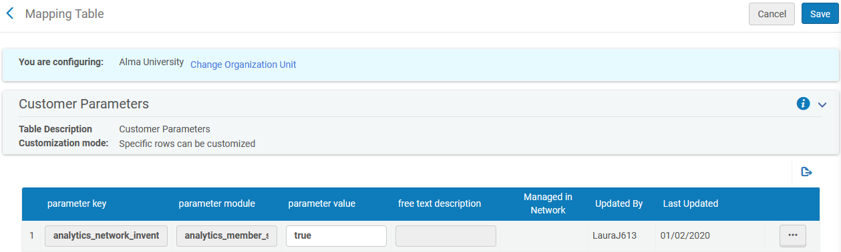
Configuration in the member institution

Slide 15

Creating reports in member institution with network zone data

Slide 16
Creating reports in member institution with network zone data
When creating reports in the member institution and wanting to display Network Zone data, use the fields from E-Inventory > Portfolio Details for Consortia.
When creating reports in the member institution without Network Zone data, use the fields from other dimensions (not from “Portfolio Details for Consortia”).

Slide 17
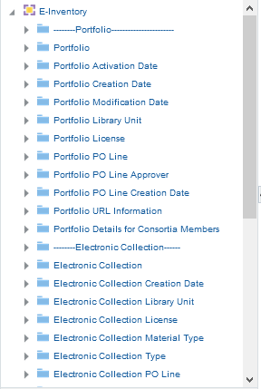
Creating reports in member institution with network zone data
Member institution data
Network institution data

Slide 18
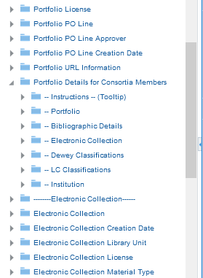
Creating reports in member institution with network zone data
This is the data from the network zone which can be viewed in a report made by the member institution

Slide 19
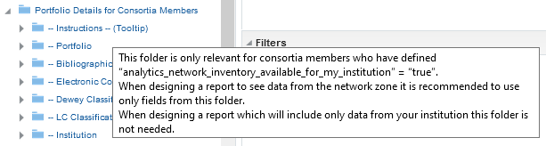
Creating reports in member institution with network zone data
As the tooltip states:
When creating reports and using the fields from “E-Inventory > Portfolio Details for Consortia” only fields from “Portfolio Details for Consortia” should be used.
One report should not mix fields from those under “Portfolio Details for Consortia” with other fields.

Slide 20
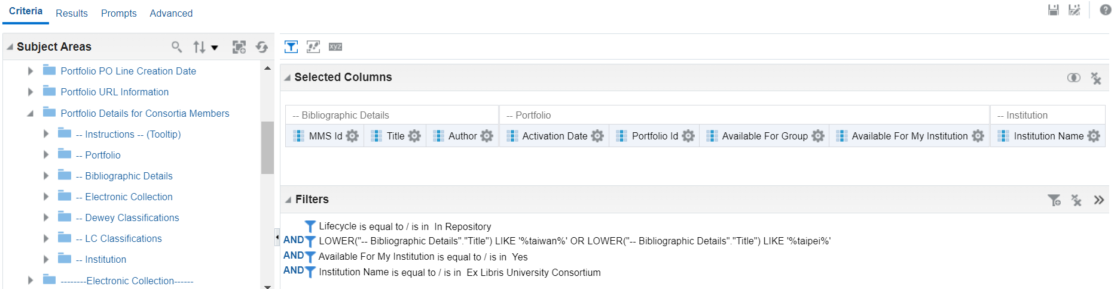
Creating reports in member institution with network zone data
Here is an example of the criteria tab of a report created in the “Alma University” member institution which will show data from the network zone
Folder names with data from the network zone begin with --”
The filters should also only come from “Portfolio Details for Consortia” folder

Slide 21
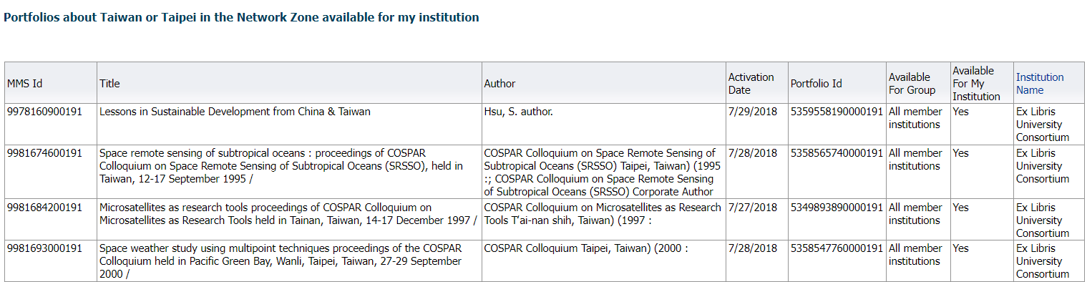
Creating reports in member institution with network zone data
Here is the resulting report.

Slide 22
Creating reports in member institution with network zone data
On the previous slide we see that MMSID 9978160900191 “Lessons in Sustainable Development from China & Taiwan” is in institution “Ex Libris University Consortium” (which is the Network Zone) and is “available for my institution” (Alma University).
On the next slide we look at a repository search for this MMSID in Alma University and see that this really is the case.

Slide 23
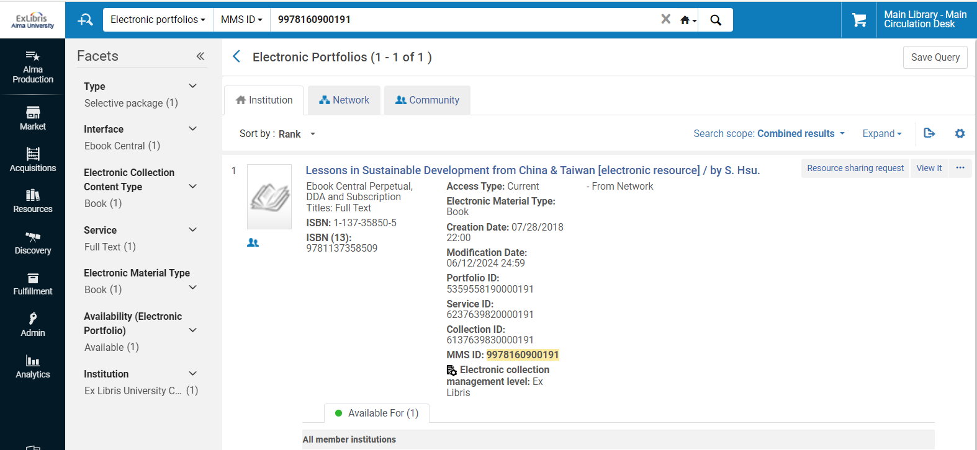
Creating reports in member institution with network zone data
We found this when searching the institution tab because the scope is “Combined Results”
Searching member institution “Alma University”
This record is From Network
Available for All member institutions (which includes Alma University)

Slide 24
xxx@exlibrisgroup.com

